Slide 1
Chapter 01 Introduction
Dr. Steffen Herbold
herbold@cs.uni-goettingen.de

Slide 2
Outline
Introduction to Big Data
Data Science and Business Intelligence
The Skillset of Data Scientists
Summary

Slide 3


What is „Big Data“?!?
Is this really about size?

Slide 4
Naive Definition
Naive definition:
Big data only depends on the data size
1 Gigabyte? 1 Terabyte? 1 Petabyte?
Naive interpretation misses important aspects
Time:
Analyzing 1 Gigabyte of data per day is different from analyzing 1 Gigabyte of data per second
Diversity:
Analyzing spread sheets with numeric data is different from analyzing Web pages that contain a mixture of text and images
Distribution:
Analyzing data from a single source is different from analyzing data from multiple sources

Slide 5


Definition of Big Data
Following Gartner‘s IT Glossary:
Big data is high-volume, high-velocity and/or high-variety information assets that demand cost-effective, innovative forms of information processing that enable enhanced insight, decision making, and process automation.
The three Vs
Volume
Velocity
Variety
Some people actually use 10 Vs to define big data!
Variability
Veracity
Validity
Vulnerability
Volatility
Visualization
Value

Slide 6
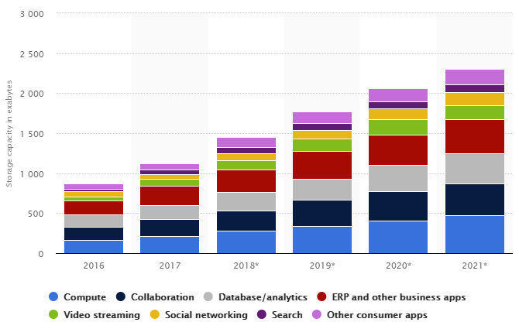
The 3 Vs: Volume
Scale of the data must be „big“
No clear definition
„that demand […] innovative forms of information processing“ (Gartner)
Data center storage worldwide
© Statista 2018

Slide 7

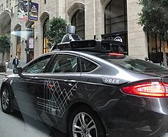

The 3 Vs: Velocity
Speed at which new data is created
Speed at which data must be processed and analyzed
Often close to real-time

Slide 8
The 3 Vs: Variety
Diversity in data types and data sources
Structured
Semi-Structured
Quasi-Structured
Unstructured
Data with defined types and structure
Example: comma separated values
Textual data with parseable pattern
Example: XML files with schema
Textual data with erratic formats that can be formated with effort
Example: Clickstream data
Data that has no inherent structure, often with multiple formats
Example: Web site, videos

Slide 9
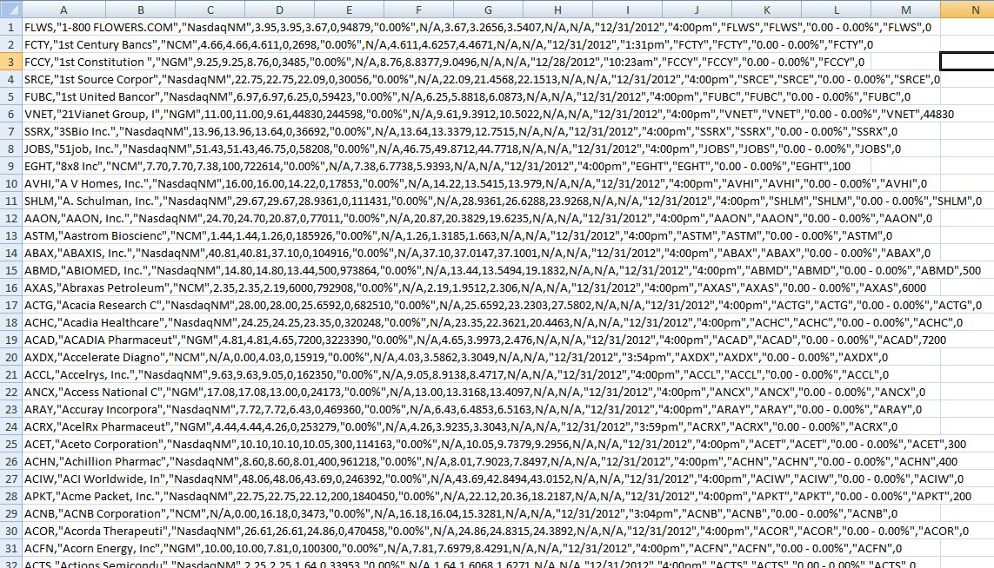
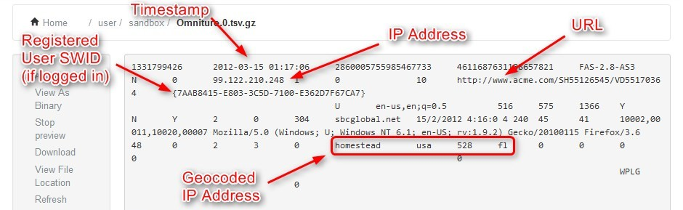
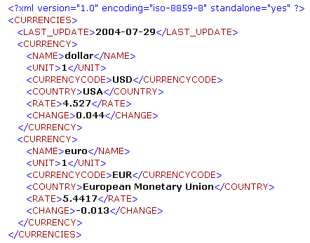
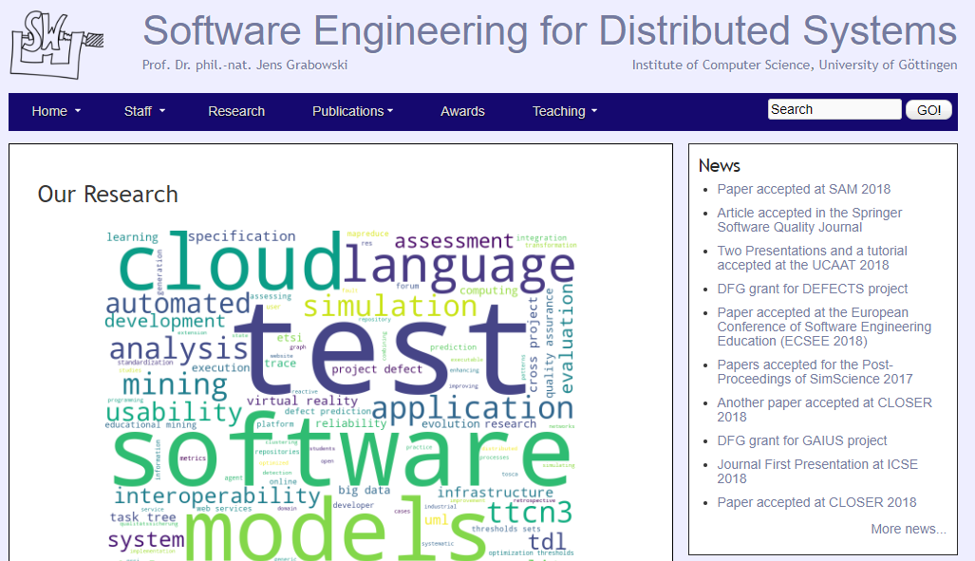
Examples for data types
Structured
Quasi-Structured
Semi-Structured
Unstructured

Slide 10
Outline
Introduction to Big Data
Data Science and Business Intelligence
The Skillset of Data Scientists
Summary

Slide 11
Defining Data Science
Unfortunately, there is no clear definition (yet?)
Goal is the extraction of knowledge from data
Combination of techniques from different disciplines
Scientific principles guide the data analysis

Slide 12

What is „Data Science“?!?
Tools? Big Data? Machine Learning?

Slide 13
Mathematical Aspects
Computational Geometry
Optimization
Stochastics
Machine Learning
Scientific Computing

Slide 14
Computer Science Aspects
Data Structures and Algorithms
Databases
Distributed Computing
Software Engineering
Artificial Intelligence
Machine Learning

Slide 15
Statistical Aspects
Linear Models
Statistical Tests
Inference
Time Series Analysis
Machine Learning

Slide 16
Applications
Intelligent Systems
Robotics
Marketing
Social Networks
Medicine
Autonomous Driving

Slide 17
Data Science vs. Business Intelligence
Business Intelligence (Gartner IT Glossary)
[…] best practices that enable access to and analysis of information to improve and optimize decisions and performance.
High
 | Business Intelligence | Data Science
Techniques | Dashboards, alerts, queries | Optimization, predictive modelling, forecasting
Data Types | Structured, data warehouses | Any kind, often unstructured
Common questions | What happened…? How much did…? When did…? | What if…? What will…? How can we…?
Depth of Insights
Data Science
Business Intelligence
Low
Past
Present
Future
Time

Slide 18




















More Data → More Opportunities
TERABYTES
PETABYTES
EXABYTES
LARGE
VOLUME OF INFORMATION
SMALL
1990’s
Relational Databases & Data Warehouses
2000’s
Content Management
2010’s
Key-Value Storages
& Unstructured Data

Slide 19
Outline
Introduction to Big Data
Data Science and Business Intelligence
The Skillset of Data Scientists
Summary

Slide 20
What are Data Scientists?
Not computer scientists
But should know about databases, data structures, algorithms, etc.
Not mathematicians
But should know about optimization, stochastics, etc.
Not statisticians
But should know about regression, statistical tests, etc.
Not domain experts
But must work together with them

Slide 21
Skills of Data Scientists
Data Scientists
Quantitative
Skeptical
Collaborative
Technical
Programming
Infrastructures
Maths
Algorithms
Create hypotheses, but be skeptical about them
Teamwork
Communication skills
Statistics
A bit of everything
… but actually as much as possible of everything

Slide 22
Different types of Data Scientists
Data Analyzer
Analyzing data
Platform Builder
Collect data and create infrastructures
Moonlighters (50%/20%)
„Spare time“ data scientists
Insight Actors
Use the outcome and act on insights.
According to Microsoft Research:
Polymath
„Do it all“
Data Evangelist
Data analysis, disseminating and acting on insights
Data Preparer
Querying existing data, preparing data for analysis
Data Shapers
Analyzing and preparing data
Miyung Kim, Thomas Zimmermann, Robert DeLine, Andrew Begel: Data Scientists in Software Teams: State of the Art and Challenges, IEEE Transactions on Software Engineering (Online First)

Slide 23
Outline
Introduction to Big Data
Data Science and Business Intelligence
The Skillset of Data Scientists
Summary

Slide 24
Summary
Big data has a high volume, velocity, and variety
Different data structures
Structured, semi-structured, quasi-structured, unstructured
Data science is a very diverse discipline
Maths, computer science, statistics, applications
→ Data scientists require a diverse skillset

